Slide 1
Sample District Public Schools
Instructional Technology
Program Review

Slide 2
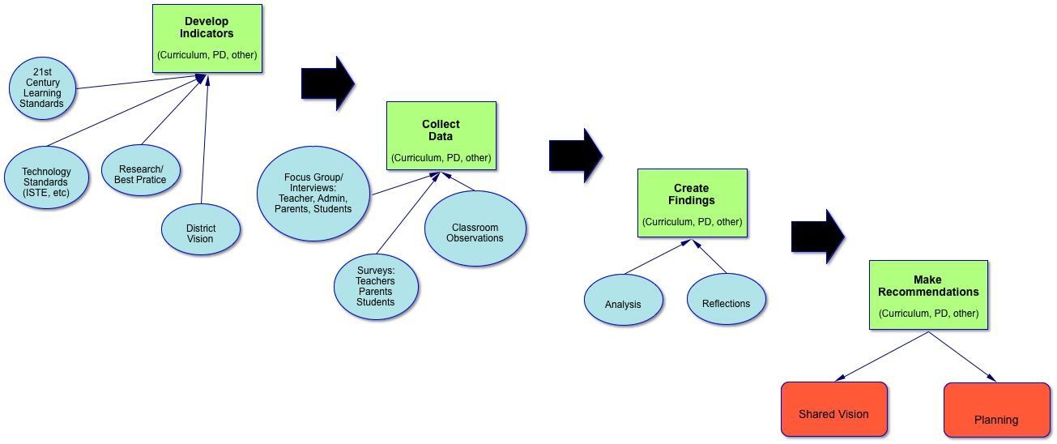
Who’s here?
Reminder of process

Slide 3
Indicators
Student Learning and Outcomes
Teacher Skills and Pedagogy
Administration and District Policy
Infrastructure
You developed these as ideals for how technology and related policy/supports should be implemented in SDPS

Slide 4
Overarching Findings
Uniformity in teacher interest and implementation
Students are using technology to produce work product and develop/improve basic content skills
Well-implemented and supported infrastructure
Excellent work by the Instructional Technology Specialist

Slide 5
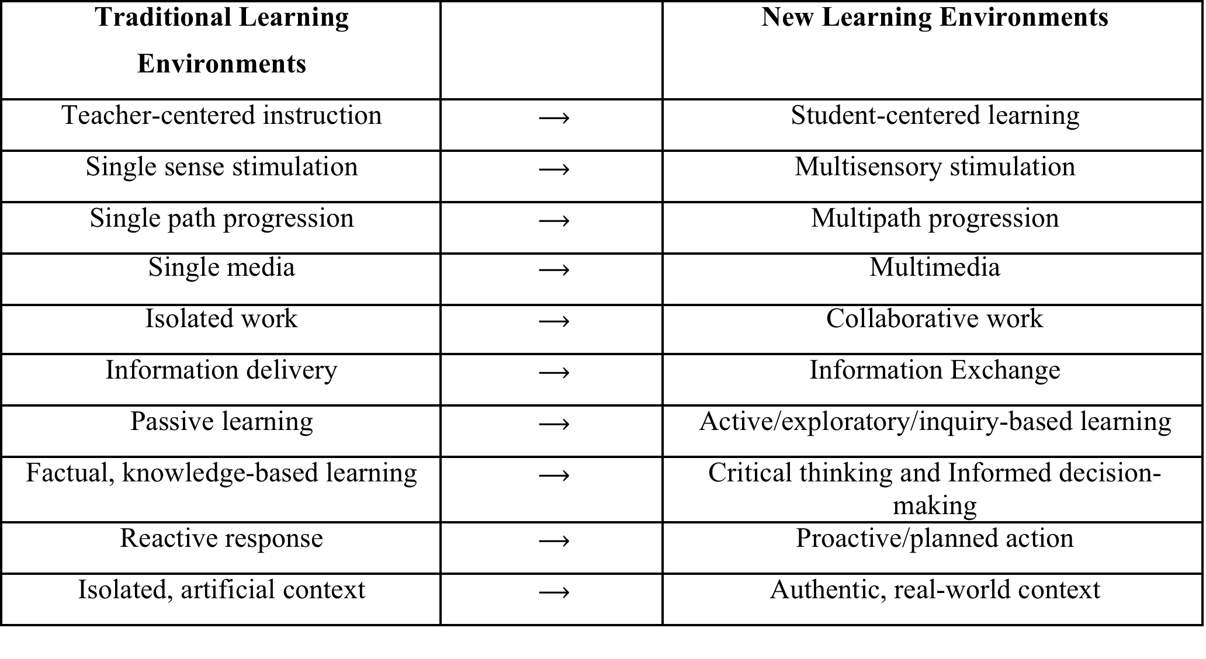
New Learning Environments
SDPS’s indicators describe students and teachers working in these new learning environments.
What does it take for SDPS to get there?

Slide 6
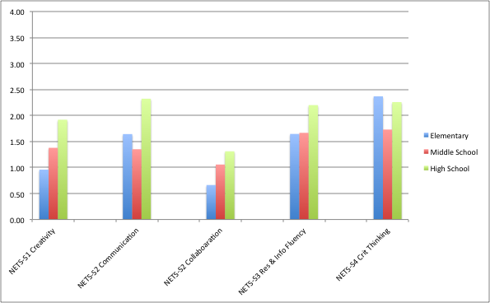
Student Skills and Outcomes
Notes:
Make the point that this is THEIR OWN SURVEY DATA … so when we say that tech is used only several times a year to support creativity, that’s what THEY are telling us. We believe this is true based on our observations and focus group data.

Slide 7
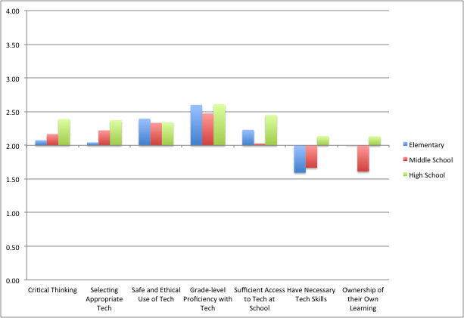
Notes:
Likewise, this is their data

Slide 8
Recommendations?
Additional teacher professional development to expand the understanding of how technology supports and develops 21st century learning skills
More instructional support (ITS)
K-12 “plan for technology integration” – a k a a scope and sequence and curriculum mapping

Slide 9
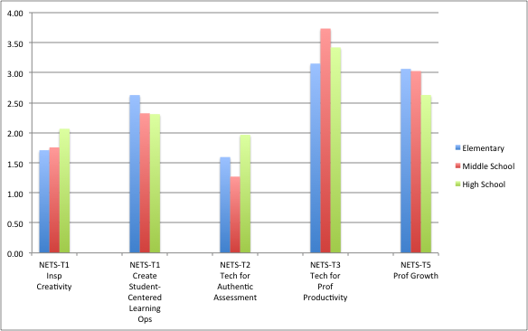
Teacher Skills and Pedagogy
Notes:
This tracks to NETS-T. Note finding about how virtually all teachers who gave examples for “authentic assessment” told us about Castle Learning…which isn’t authentic assessment (it’s assessment). This highlights the preoccupation with test-taking and the need to “expand understanding”.
Also note the high scores for “prof productivity”…this highlights the fact that teachers actually “use” technology and have access to technology.

Slide 10
Recommendations?
Again, professional development and instructional support…centered around the K-12 Integration Plan
Increasing the number of ITS is essential

Slide 11
Administration and Policy
Equity
There are concerns about equity of access to technology by all students outside of school
There are also concerns about whether or not all students have equal technology skills

Slide 12
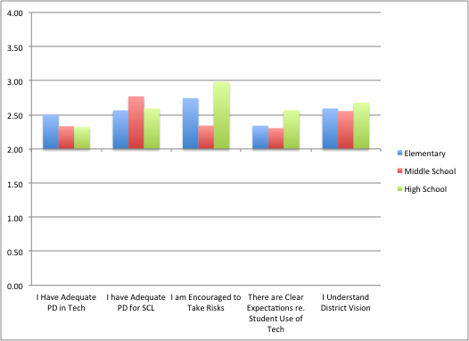
Notes:
The point here is that teachers do not strongly agree that they have clear expectations or are encouraged to take risks. These findings tie back to policy….and PD….and vision

Slide 13
Recommendations?
Equity
Scope and sequence/K-12 integration plan
So teachers know what needs to be covered
Explore 1:1…which is very nearly the case right now in terms of numbers
Vision and planning
Notes:
Explain at the end of this slide that we’re not going to have a slide about the Infrastructure indicator because their infrastructure is really fine (covered that as an “Overarching” finding) and the other things in that indicator really are matters of Policy. So let’s get right to that…and talk about planning/vision-setting as a way to put PD, staffing, etc. into place.

Slide 14
Implementation Planning
This is a recommendation, but it is central to what SDPS needs to do to move ahead.
Create a new instructional technology plan
Visionary
Not about “what is” but about “what should be”
Created by, and owned by, the entire SDPS community

Slide 15
The plan should outline how the district will address:
Teacher professional development
Technology staffing – ITS and DTC
Scope and sequence/mapping
Device allocation (PARCC, equity, etc.)
It’s not necessary to have addressed these issues before a plan is created.
The point of the plan is create a roadmap for addressing future needs.

Slide 16
Moving Forward
Sample District has much to build upon
Technology has the potential to knit together the various initiatives and challenges currently faced by the district
The district should seize the opportunity to create a vision that bridges from the current to the future
Notes:
And a plan, of course that operationalizes that vision.

