Slide 1
Mt. Vernon City School District
Technology Program Review
Findings and Recommendations

Slide 2
Mt. Vernon’s Technology Program Review
Aims to assess the current status of technology integration in district schools and classrooms
Creates a data basis for future initiatives
Not solely technology, but also the Common Core for Learning and overall student performance.
Focuses on technology’s ability to support teaching and learning, aligned with national standards and best practice

Slide 3
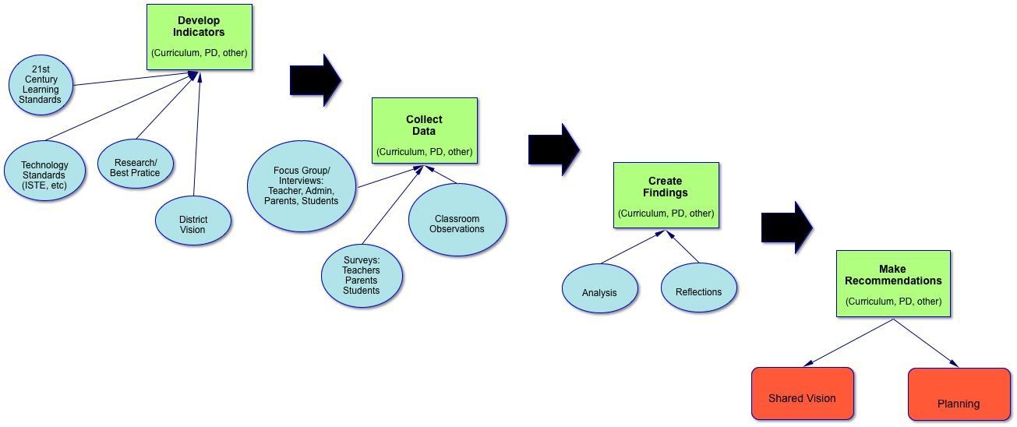
Facilitated by Sun Associates
February – May, 2013

Slide 4
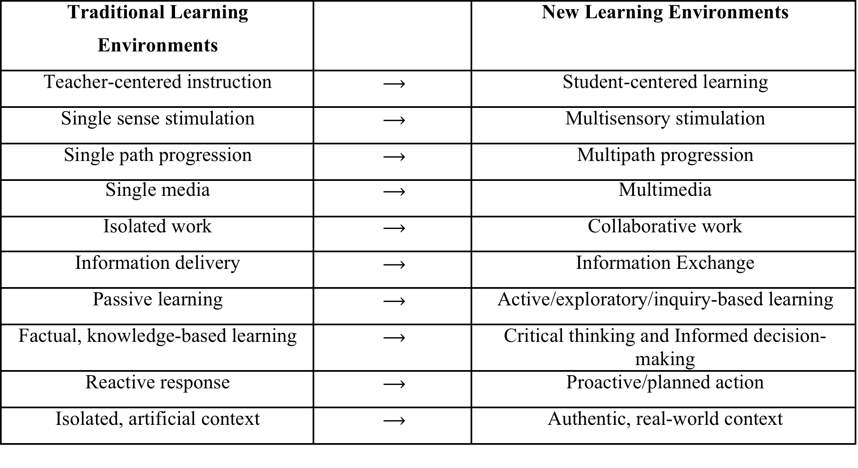
New Learning Environments
Mt. Vernon’s indicators describe students and teachers working in these new learning environments.
What does it take for Mt. Vernon to get there?

Slide 5
Standards, Frameworks, Indicators
The indicators Mt. Vernon developed for this review are…
Based in national standards and best practice
ISTE NETS
Partnership for 21st Century Learning
The same principles expressed in the CCS

Slide 6
Student Learning Indicator
Working in a technology-infused educational environment, Mt Vernon students create a variety of products, communicate and collaborate locally and globally, engage in authentic tasks, and investigate real world problems utilizing real and relevant data. Students take ownership over their learning and utilize technology to acquire and analyze information to fuel their research and thinking. Students have skills in evaluating data and information resources for their validity as well as in discerning which resources or technology would provide the most appropriate solution for completion of a task.
Students gather information to construct meaning, apply concepts, and present findings through a variety of vehicles. Students envision themselves as members of a global community while practicing safe, legal and responsible use of information and technology.

Slide 7
NETS-S 1 Creativity and Innovation
Working in a technology-infused educational environment, Mt Vernon students create a variety of products, communicate and collaborate locally and globally, engage in authentic tasks, and investigate real world problems utilizing real and relevant data. Students take ownership over their learning and utilize technology to acquire and analyze information to fuel their research and thinking. Students have skills in evaluating data and information resources for their validity as well as in discerning which resources or technology would provide the most appropriate solution for completion of a task.
Students gather information to construct meaning, apply concepts, and present findings through a variety of vehicles. Students envision themselves as members of a global community while practicing safe, legal and responsible use of information and technology.

Slide 8
NETS-S 2 Communication and Collaboration
Working in a technology-infused educational environment, Mt Vernon students create a variety of products, communicate and collaborate locally and globally, engage in authentic tasks, and investigate real world problems utilizing real and relevant data. Students take ownership over their learning and utilize technology to acquire and analyze information to fuel their research and thinking. Students have skills in evaluating data and information resources for their validity as well as in discerning which resources or technology would provide the most appropriate solution for completion of a task.
Students gather information to construct meaning, apply concepts, and present findings through a variety of vehicles. Students envision themselves as members of a global community while practicing safe, legal and responsible use of information and technology.

Slide 9
NETS-S 3 Research and Information Fluency
Working in a technology-infused educational environment, Mt Vernon students create a variety of products, communicate and collaborate locally and globally, engage in authentic tasks, and investigate real world problems utilizing real and relevant data. Students take ownership over their learning and utilize technology to acquire and analyze information to fuel their research and thinking. Students have skills in evaluating data and information resources for their validity as well as in discerning which resources or technology would provide the most appropriate solution for completion of a task.
Students gather information to construct meaning, apply concepts, and present findings through a variety of vehicles. Students envision themselves as members of a global community while practicing safe, legal and responsible use of information and technology.

Slide 10
NETS-S 4 Critical Thinking
Working in a technology-infused educational environment, Mt Vernon students create a variety of products, communicate and collaborate locally and globally, engage in authentic tasks, and investigate real world problems utilizing real and relevant data. Students take ownership over their learning and utilize technology to acquire and analyze information to fuel their research and thinking. Students have skills in evaluating data and information resources for their validity as well as in discerning which resources or technology would provide the most appropriate solution for completion of a task.
Students gather information to construct meaning, apply concepts, and present findings through a variety of vehicles. Students envision themselves as members of a global community while practicing safe, legal and responsible use of information and technology.

Slide 11
NETS-S 5 Digital Citizenship
Working in a technology-infused educational environment, Mt Vernon students create a variety of products, communicate and collaborate locally and globally, engage in authentic tasks, and investigate real world problems utilizing real and relevant data. Students take ownership over their learning and utilize technology to acquire and analyze information to fuel their research and thinking. Students have skills in evaluating data and information resources for their validity as well as in discerning which resources or technology would provide the most appropriate solution for completion of a task.
Students gather information to construct meaning, apply concepts, and present findings through a variety of vehicles. Students envision themselves as members of a global community while practicing safe, legal and responsible use of information and technology.

Slide 12
So, what has this evaluation found regarding the degree to which students are meeting these standards in Mt. Vernon’s schools?

Slide 13
Overarching Finding
A teacher notes…
The computers here at [this elementary school] are older than my fourth grade students. Many days I try to log on to eschool to complete the attendance and my own dell computer won't sign on. Half of the computers in our computer lab don't work so it is extremely frustrating to take a class in there and spend most of the period getting computer to sign on. An investment must be made in technology in order for teachers here … to use computers for assessment purposes.

Slide 14
Another…
About 11 years ago, for a short period of time I was allowed to use a classroom set of laptops for my students. It was an experimental project and after a year I never got to use the laptops again. The Internet was a wonderful resource for my students to research information in real time. I could help them immediately if they ran into a dead end while researching. Since then I only have an overhead and one computer, sometimes a tv.

Slide 15
Parents....
Research for her BHM research paper. She was unable to do this at school since their is no media specialist or updated computers. She also used the computer at home to do research for her science project, she also learned to create charts and graphs
Nothing. Anything that required technology she did at home.

Slide 16
To a large extent, the indicators are irrelevant since there simply is no district-wide technology infrastructure.
Nevertheless, teachers and parents do express an interest in using technology as a tool for teaching and learning
There is tremendous promise, just not much progress.

Slide 17
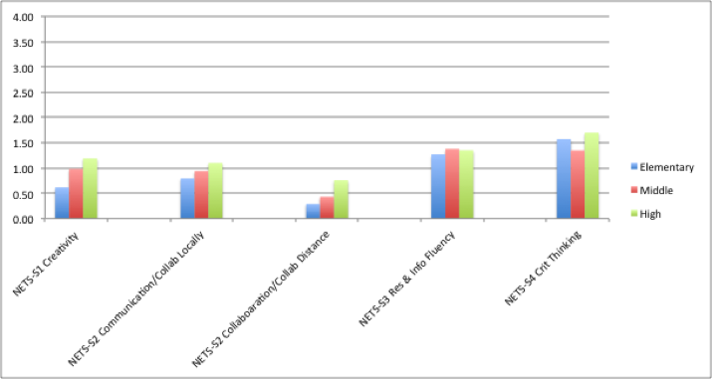
Student Learning and 21st Century Skills
Students and teachers do not make use of technology to support 21st century learning…because there is no effective infrastructure, instructional support, or expectation
0 = Never, 1 = Several times a year, 2 = Several times a semester, 3 = Two or three times a month, 4 = At least once a week.

Slide 18
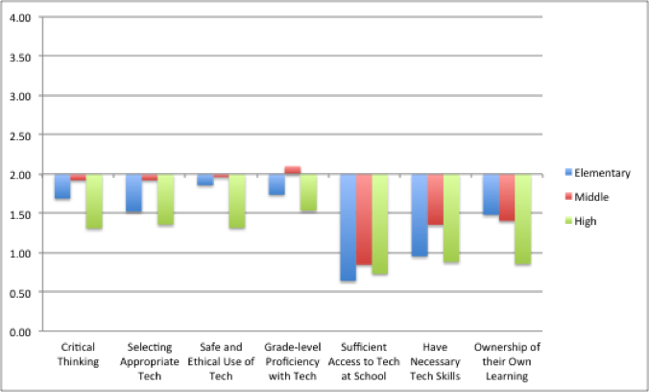
4 = Strongly Agree, 3 = Agree, 2 = Neutral, 1 = Disagree, 0 = Strongly Disagree

Slide 19
Bottom Line
All of the data – for all of the indicators, not just the student skills indicator – point to the fact that there simply is no viable technology infrastructure or technology support system for Mt. Vernon’s students or teachers.

Slide 20
Recommendations
Develop a vision for how Mt. Vernon’s students will develop 21st century skills in a 21st century learning environment.
An environment where there is:
Available technology infrastructure
Responsive and skilled technical support
Instructional support to provide embedded professional development
These elements would be a start, and would provide a basis for further growth.

Slide 21
Articulate the vision through a strategic plan
Engage stakeholders in the visioning and plan-creation
The vision has to be owned by the community
Although, the district should meet teachers at least half way as a show of good faith
This means improve your infrastructure NOW

Slide 22
Start the planning effort this summer
Planning should be lead by curriculum and instruction
Technology has the potential to knit together the various challenges and initiatives faced by Mt. Vernon
Seize the opportunity to create a vision that bridges from the present to the future.

