Slide 1
Winchester Public Schools
Instructional Technology
Program Review Report

Slide 2
March – May, 2013
Commissioned by Superintendent McAlduff
To acquire a “snapshot” of the district’s current performance in utilizing technology as a tool for teaching and learning
Facilitated by Sun Associates

Slide 3
The Technology Program Review Process
Creates a data basis for future initiatives…including those many that can be supported by technology (e.g., Common Core for Learning)
Focuses on technology’s ability to support teaching and learning, aligned with national standards and best practice
Framed by descriptive performance indicators created by Winchester teachers and administrators
The basic approach has been a facilitated self-assessment

Slide 4
Indicators, Standards, and Data
Indicators…
Winchester’s Indicators (February, 2013)
ISTE NETS
ISTE Essential Conditions
Common Core
Best Practice
Data….
Surveys – Teacher and Parent
Observations
Principal Interviews
Focus Groups
Other Interviews

Slide 5
The Indicators Say That Technology Supports and Catalyzes…
Student Skills and Outcomes
Focus on thinking and life-long learning skills
Critical thinking, collaboration, communication
Responsible digital citizens
Teacher Skills and Pedagogy
Student-centered learning that develops higher-order thinking skills
Professional development that supports on-going teacher learning

Slide 6
Administration and District Policy
Administration creates and effectively communicates a vision for technology as an essential tool for teaching and learning
Technology is adequately funded and supported across the district
These are the indicators that framed the program review

Slide 7
Overarching Finding
Teachers and parents across the district feel that technology has a positive impact on student learning
Yet, beyond this positive feeling, there is not a commonly-held vision among teachers, administrators or parents for how technology should systemically support teaching and learning in Winchester Public Schools.
The lack of a common vision – and a plan – are frequently cited as the root problem with technology integration in the district.

Slide 8
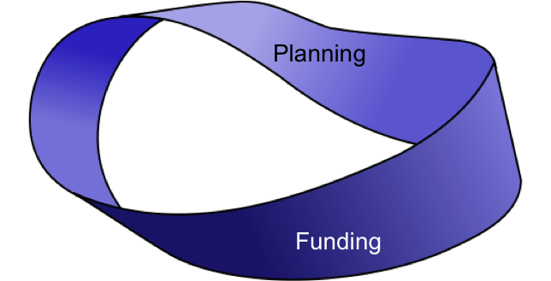
Clearly, money and resources are problems as well. But…
It’s difficult to marshal the required resources without a plan that operates at the district level.
The result is the lack of equity expressed by many teachers and parents, and the overall low level of technology integration across the district.

Slide 9
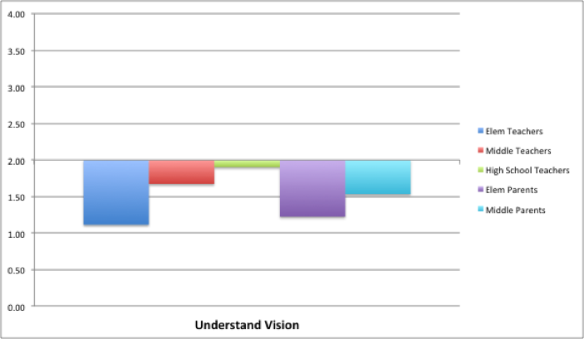
“Understand Vision”
There is no clearly understood vision

Slide 10
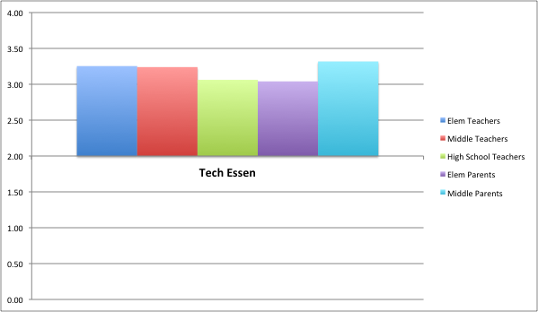
“Technology is essential”
And yet, everyone agrees that technology is essential to teaching and learning!

Slide 11
Student Use of Technology
Most technology in Winchester is used by teachers for teacher-directed instruction.
Even when the technology is in student hands, it is nearly always teacher-directed.
There are a few notable exceptions, but these are relatively rare.

Slide 12
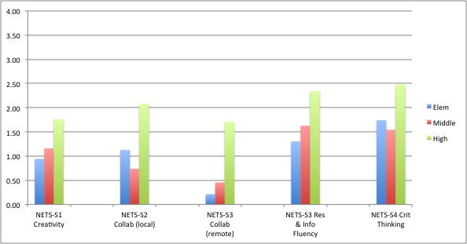
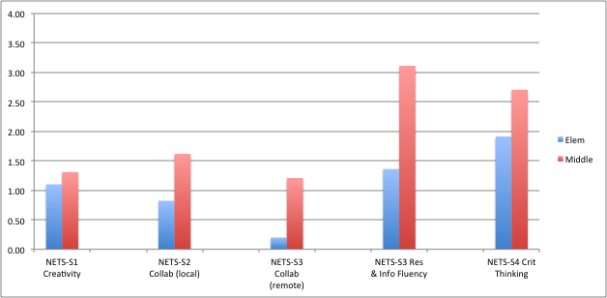

Slide 13
Student exposure to technology as a tool for learning varies according to building, grade, and/or individual teacher.
There is no “mapping” of student technology skills onto grade or subject area curriculum.
Hence, student technology skills as well as broader concepts such as “digital citizenship” and “information literacy” are haphazardly addressed.

Slide 14
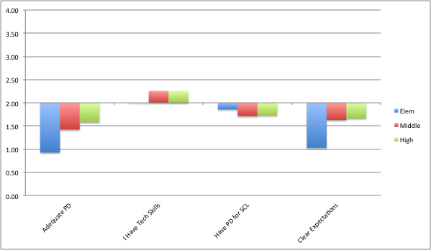
Teacher Skills

Slide 15
Teachers are eager to do more with technology
But without resources (e.g., bulbs for projectors), technical support, or instructional support (job-embedded professional development), they are doing about all they can do.
Student-centered learning requires considerable support and training

Slide 16
Administration and Policy
Technology’s role in supporting student-centered learning requires a strong vision.
And clear expectations
And the supports necessary to meet those expectations
Technology infrastructure
Technical support
Instructional support

Slide 17
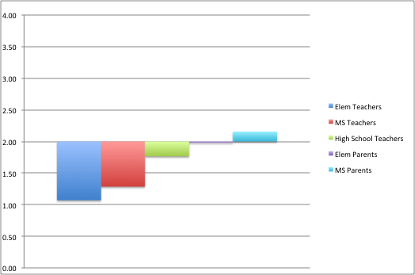
Student Access to Technology

Slide 18
Recommendations
Develop a strategic technology plan
A collaborative, stakeholder-driven, process
Rooted in a clear and strong vision
Addresses issues of staffing
Infrastructure design
Technical support
Instructional support and teacher professional development
The current effort of a town override for network improvements is a critical first step toward building the infrastructure that will support technology planning.

Slide 19
Of particular importance in the plan is the need to define and frame the work of the ITS.
Should be focused on helping teachers implement a K-12 scope and sequence of student technology skills and practices
These skills should be embedded in a comprehensive curriculum map that develops NETS-S skills within the context of core academic curriculum/CCL
Again, the ITS are working on this now…but their efforts need to be framed by the plan.

Slide 20
Next Steps?
The district could start its planning work this summer.
The arrival of a new Assistant Superintendent for Curriculum and Instruction is an ideal opportunity
Planning should not stop any on-going work, but rather should frame and energize current efforts and assure clarity in future work

