Slide 1
Vision
For Technology-Supported 21st Century Learning
Goals
Student Learning, Teacher Use/Pedagogy, District Supports
Action Plans
1 Action Plan for Each Goal, Covering All 3 Years of the Plan

Slide 2
The Evaluation
Indicators
Data
Recommendations
Findings

Slide 3
The Plan
Vision
The Evaluation
Indicators
Data
Recommendations
Findings

Slide 4
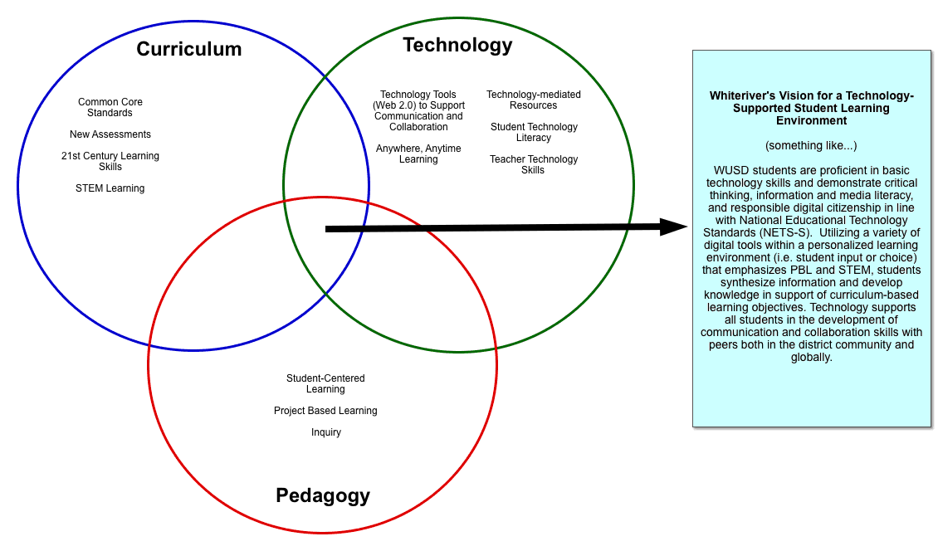

Slide 5
The Plan
Vision
Goals
The Evaluation
Indicators
Data
Recommendations
Findings

Slide 6
Possible Goals
Students use technology in ways that support learning and the achievement of core curriculum objectives.
Students develop and demonstrate facility with a range of technologies, choosing appropriate tools to communicate, collaborate, analyze information, solve problems and create products to present their ideas.
Technology tools are used for research and provide students with opportunities to develop and apply critical thinking skills related to information, source, and perspective.
Classrooms are active, varied environments where students use technology to enhance authentic, relevant learning experiences tailored to individual learning styles and needs.
There is a clear set of expectations for student computer literacy that is articulated through a K-12 scope and sequence of technology skills.
Student computer literacy is achieved through the integration of technology skills across the curriculum.
Teachers use technology as a productivity tool for their professional work, communicating regularly with students, staff, and parents/community members and accessing resources for professional development.
Teachers demonstrate facility with a wide range of technology tools, and can articulate the value that technology brings to their instruction and to the learning environment in the classroom.

Slide 7
The Plan
Vision
Goals
Action Plans
The Evaluation
Indicators
Data
Recommendations
Findings

